Slide 1
Swept Boss/Base
Solidworks, a tutorial

Slide 2
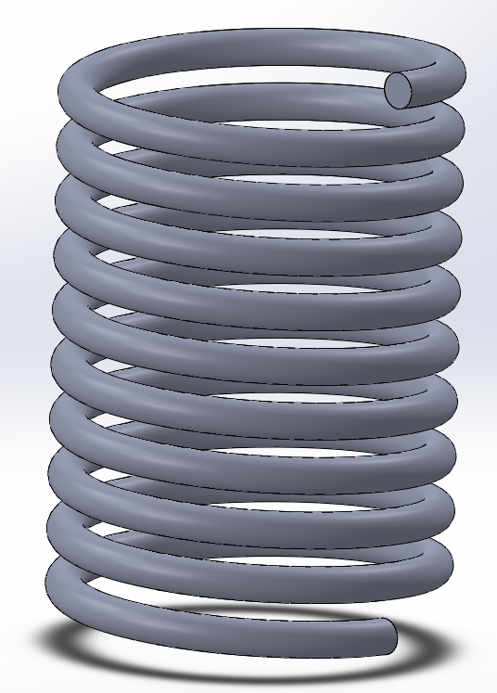
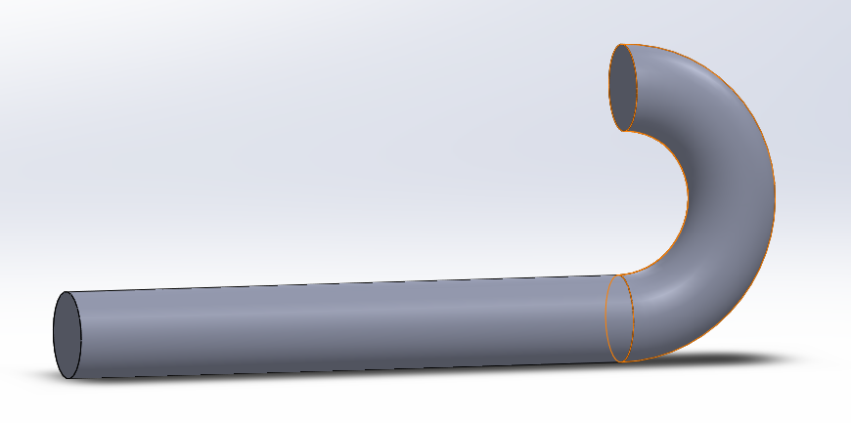
Swept boss/base
The Swept boss/base feature is most commonly used as a constrution tool for making basic or complex 3D-models.
It can be used to create all kinds of models, generally you use this feature to create models like springs, cables, tubes and generally anything that have a certain path.
The swept boss/base is based upon two sketches, a path and a contour, the feature will create a part with the sketch of the contour following the sketched path in the other sketch.
In the following tutorial you will learn how to operate the Swept boss/base feature of the Solidworks software.
I will during this presentation make a tube and a spring.

Slide 3
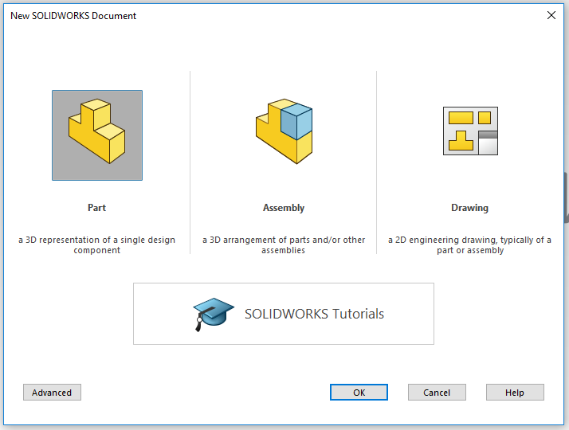
Open SolidWorks
Start by opening the program SolidWorks.
Open a New Dokument.
Click on Part.
A new Solidworkspart will open.

Slide 4
Good to know before you sketch
Before you sketch it´s important to know that you will need to:
Create two sketches. One which decribes the contour/profile of your part and one that decribes how the path of the profil will need to look.
Important to start draw your sketches at the origo of your drawing area if possible. You can draw anywhere in the drawing area but then in order to get the other sketch in the correct place you will need to add a new plane manually.

Slide 5
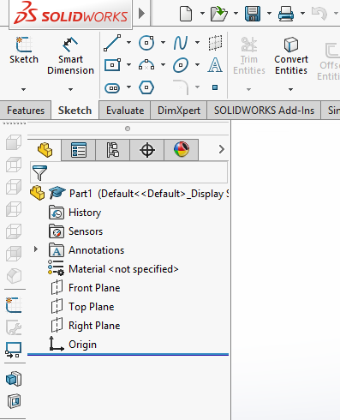
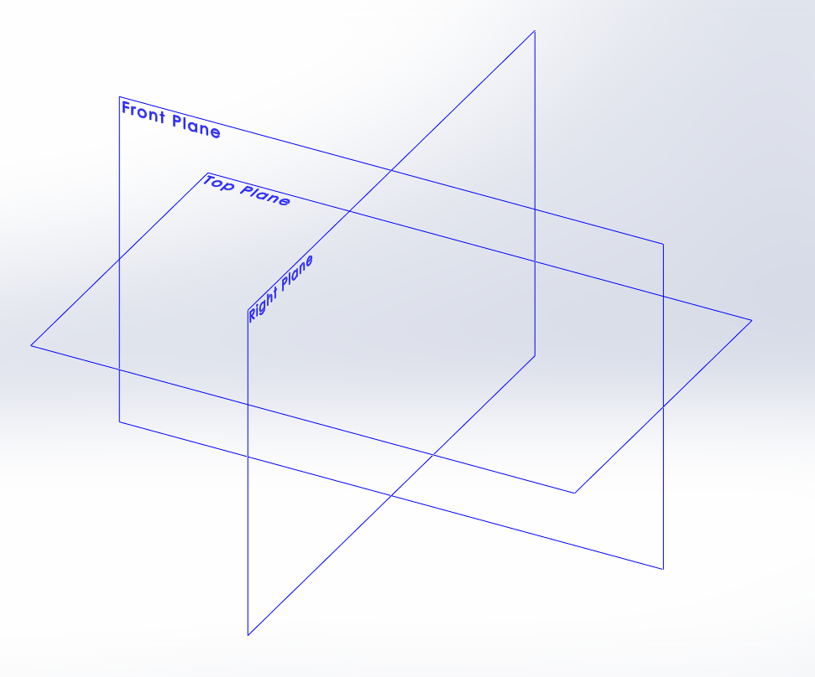
Sketch your part
Click on the tab Sketch in the Command Manager toolbar. All sketch tools will be shown. (As the picture to the right)
Click the icon Sketch.
In your area of drawing, three planes will be shown as in the picture below. Front plane, Top plane and Right plane. Think of them as (Front plane) a front wall in a room, (Top plane) the floor in the room and (right plane) as the right wall.
Pick the plane you need by clicking on it..

Slide 6
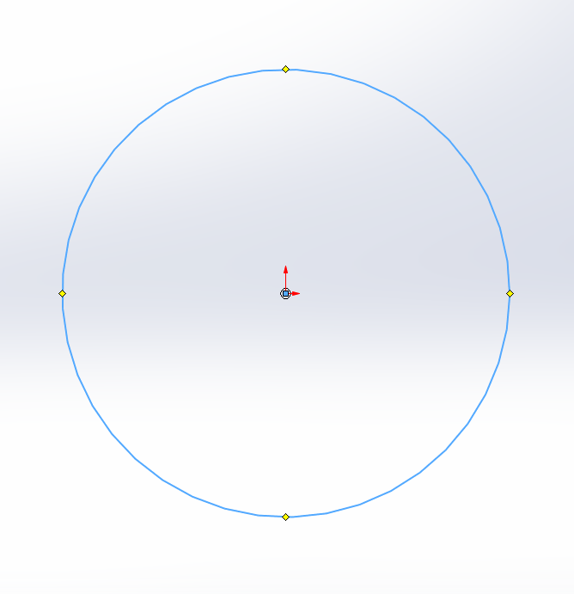
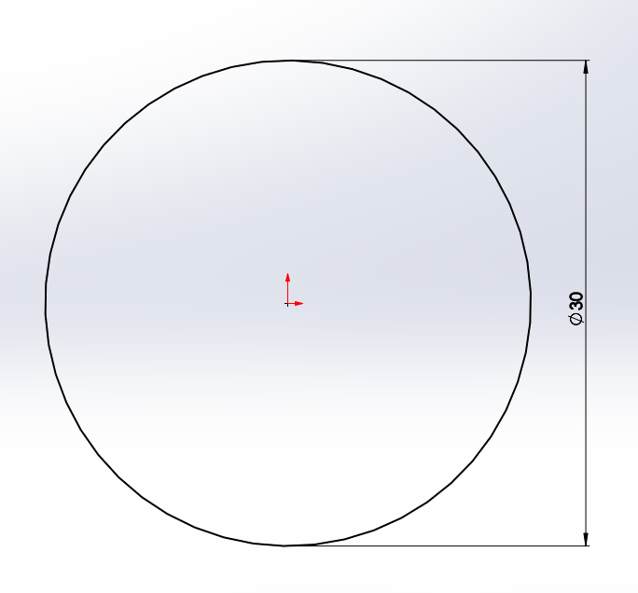
Sketch the profile of the tube
I chose the front plane for my specific part.
Click on the drawing tool Circle. Always base your sketch on the origo in your drawing area like i did in the picture. It will make it easier to later create the path. It will also make sure that your sketch is fully defined when you measure it in the next step. And it will also make sure that you can find the centre of your part which can be very useful.
Now it´s time to give your part the right measurements. Click on the tool Smart Dimension. Click on the line you want to measure. And then click besides the line and a pop-up will show, here you enter the value you want the diameter of the part to be. I will have my circle diameter 30mm.
(if you want the tube to be hollow, add another circle inside the first and give it a smaller measurment like 26mm, it will make the tube hollow when you use the feature Swept boss/base..)

Slide 7
Finishing a Sketch
When your Sketch looks like the picture to the right,(all lines black which means that the sketch is fully defined) you have added all the measurements required. If you have a blue line it means that some measurement is missing and if you have a red line you have the same measurement twise or more.
Now the Sketch is done and we will accept the sketch by clicking the icon Exit Sketch.

Slide 8
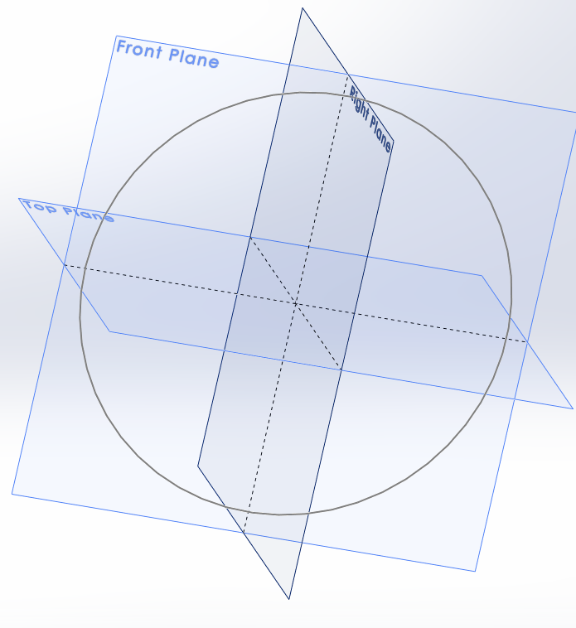
Creating the sketch for the path
Now that i am going to create a new sketch I can use any plane but the front plane that i already used. As you can see on the picture the right and top plane cuts right through the center of my circle.
And you can see how the origo that i drawed on at the front plane is the origo of the other planes as well. That is how i know i will create my sketch of the path in the center off the circle.

Slide 9
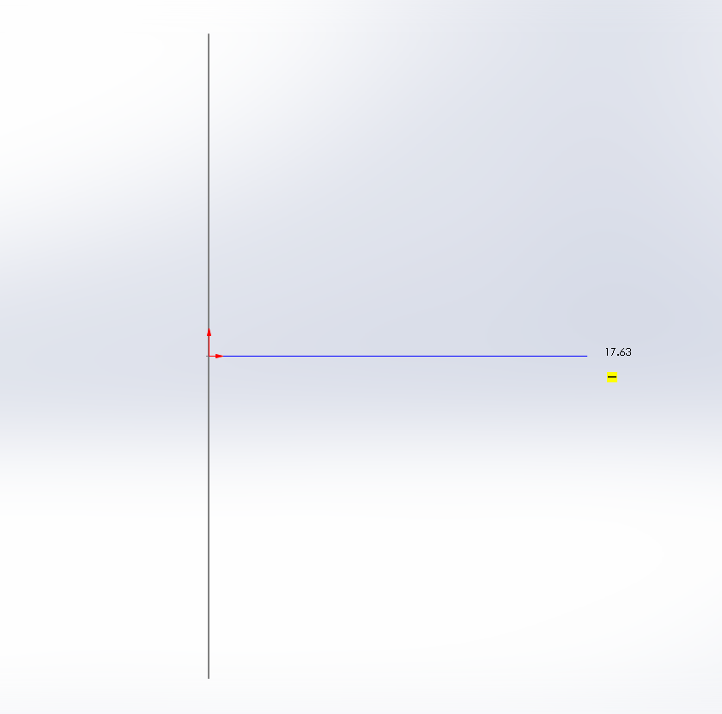
Create the path
Open a new sketch (i took the right plane).
Use the different drawing tools to create the path of your part.
The grey line on the picture is my circle seen sideways. You then start drawing you path from the origo like the picture. From there you can go anywhere. You can do a straight line forward, a curved line or a straight line and then curved line on the end of that line.
I will make a straight line (200mm) and then add a arc at the end to make it look like a hook. You can see how on the next slide.

Slide 10
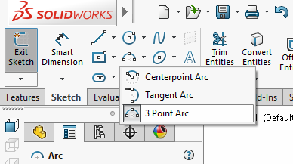
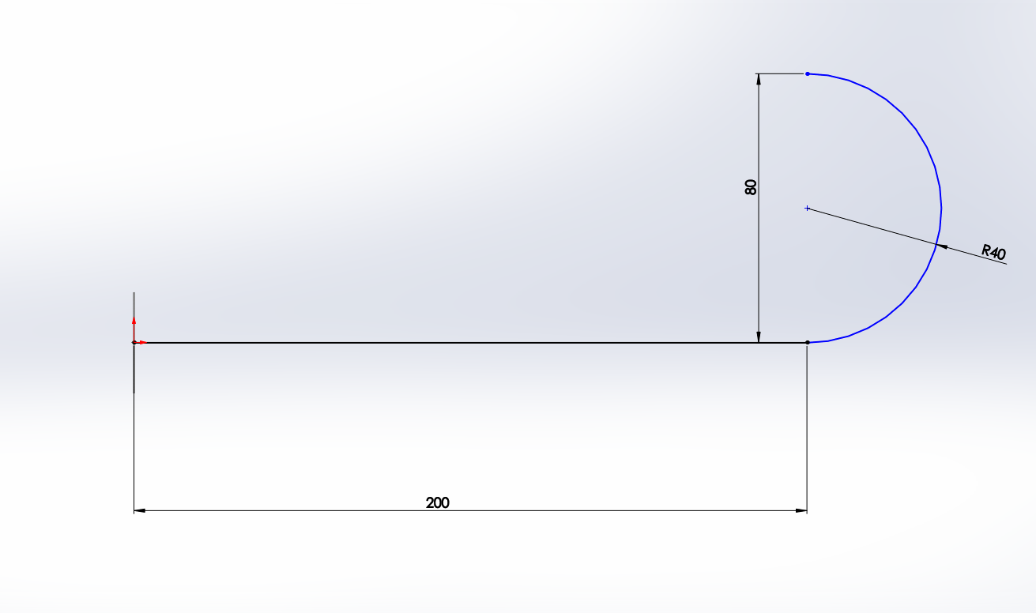
Adding the arc
Start by choosing the 3 point arc sketch tool and then click on the end of the 200mm line, drag the cursor straight up and click again. You then get to decide how big arc you want, this step dosen´t really matter because it will change according you measurments you set with Smart Dimension. I took the radius 40mm.

Slide 11
Finishing a Sketch
Now the Sketch is done and we will accept the sketch by clicking the icon Exit Sketch.

Slide 12
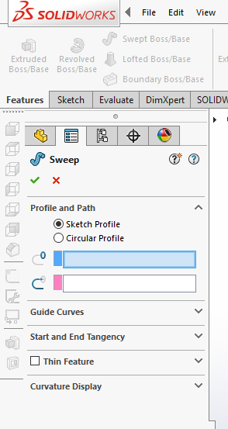
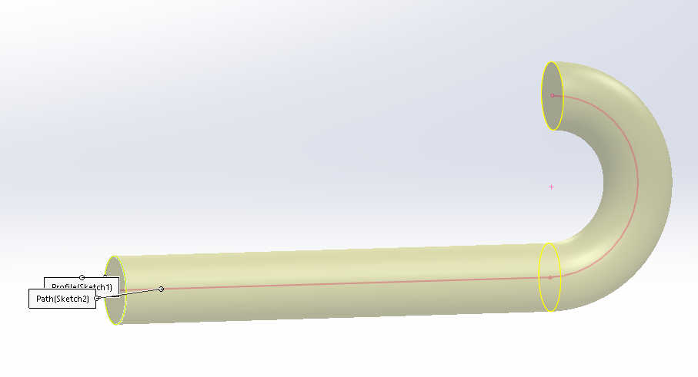
Using the Swept boss/base feature
Click on the icon Swept boss/base and the feature toolbar should open on your left side.
On the toolbar you have two boxes. One for the profile and one for the path. Click on the one for the profile and then click on the circle of your sketch. And then click on the box for the path and then click on the path in your sketch.
You should then get a preview of your Swept boss/base.
Click the green ok and you will have a finished part.

Slide 13
Continue to work on your part
In order to continue to work on your part you can do almost anything. You can add material or remove material.
You can use this feature to create very complex paths, but make sure that you never have the path crossing itself, it will give you problems that you can easy avoid in order by creating two separete features.
Good luck!
Now I will go on and create a spring.

Slide 14
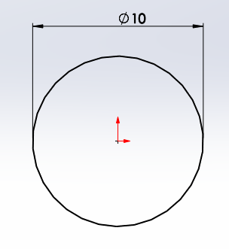
Helix and Spirals
Start by clicking on the Helix and Spiral tool.
It will start by opening a new sketch for you, all you have to do is choose a plane. I picked the top plane.
The tool will want you to draw a circle so that it will know how big your helix/spiral will be. Draw a circle and give it measurments with the Smart Dimension tool. I gave my circle the diameter 10mm.
When you have done that you exit the sketch i order to give the spiral its pitch. Click the icon that says Exit Sketch.

Slide 15
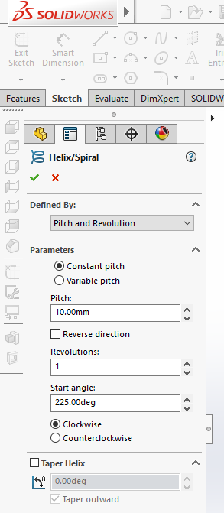
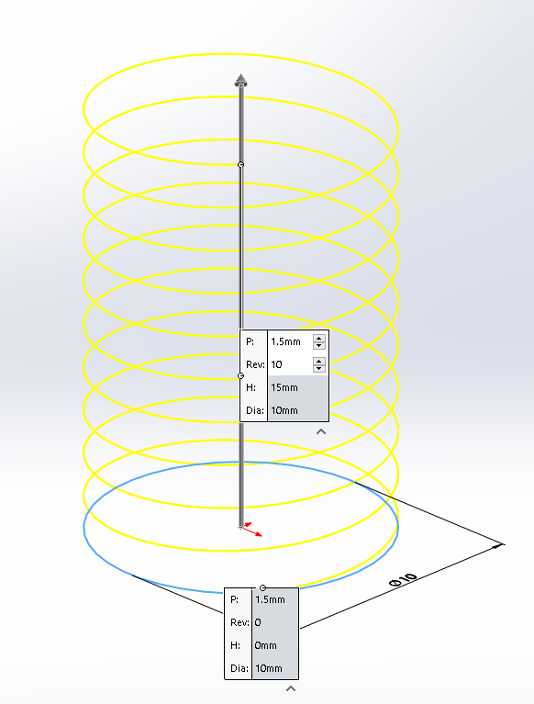
The Helix/Spiral toolbar
The toolbar will have you describe how many revolutions the spiral should be and how big the pitch should be in between the revolutions. I will have mine: Pitch:1,5mm and Revolutions:10 and start angle:0deg
it should look like my picture then.
When you are satisfied with your helix/spiral click the green OK.
It should leave you with a sketch of a spiral.

Slide 16
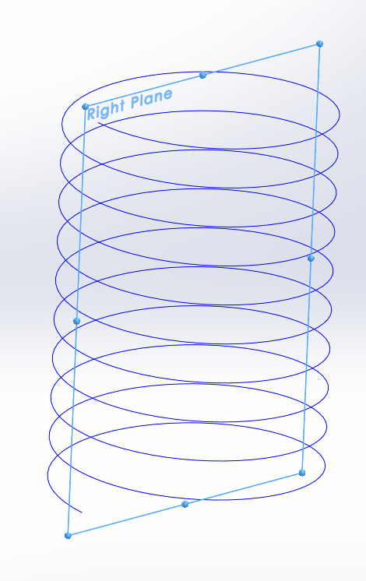
Creating the profile
In order to create the profile we need to create a new sketch and there by start by deciding what plane to draw on. You should always in order to get as good profile as possible have a plane that is at the end or beginning of the spiral. In this case the right plane is perfect as you can see on the picture. It was when we entered the Degrees into the helix/spiral toolbar that i choose the value:0 that made it start and stop at the right place.
So open a sketch on the right plane.

Slide 17
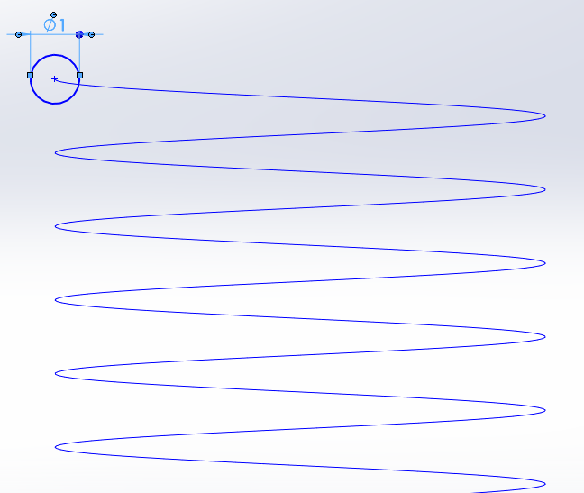
Sketch
Now you sketch your profile. I picked a circle and gave it the measurment dia=1mm. It´s important that you put the circle on the end of the spiral. Otherwise it will not work.
When you have made your sketch and measured it you exit the sketch.

Slide 18
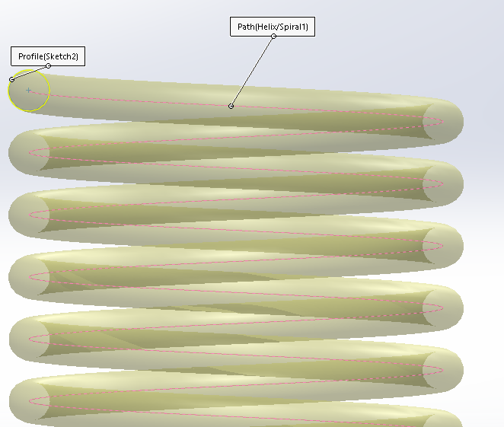
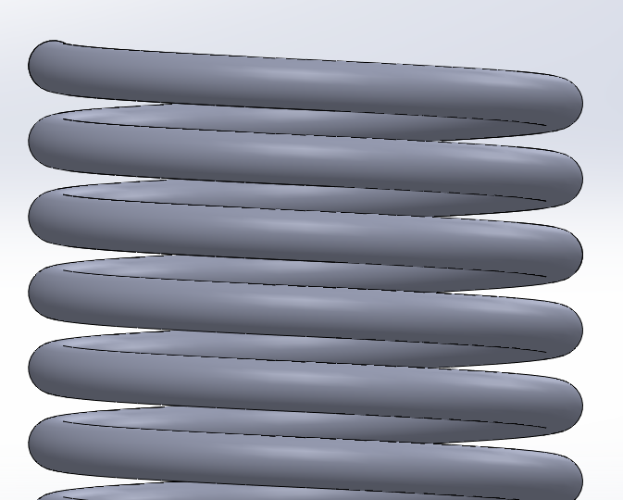
Using the Swept boss/base feature
Click on the icon Swept boss/base and the feature toolbar should open on your left side.
On the toolbar you have two boxes. One for the profile and one for the path. Click on the one for the profile and then click on the circle of your sketch. And then click on the box for the path and then click on the path in your sketch.
You should then get a preview of your Swept boss/base.
Click the green ok and you will have a finished part.

Slide 19
Good luck!

